Slide 1



Dr. D. Y. Patil Institute of Technology, Pimpri, Pune
Department of First Year Engineering
Project Guide: Ms. Aarti Jathar

Slide 2


GROUP MEMBERS
Mr.Aryan Mule
Disease Diagnosis Using ML
Mr.Nikhil Mulay
Mr.Ruturaj Jawale
Mr.Pranav Yedave
Mr.Aditya Tungatkar

Slide 3
Introduction
Types Of Data use for Disease Diagnosis
Common ML Techniques
Methodology
Model Training And Validation
Benefits of ML
Challenges With Implementation
Future Directions
Table of Content

Slide 4
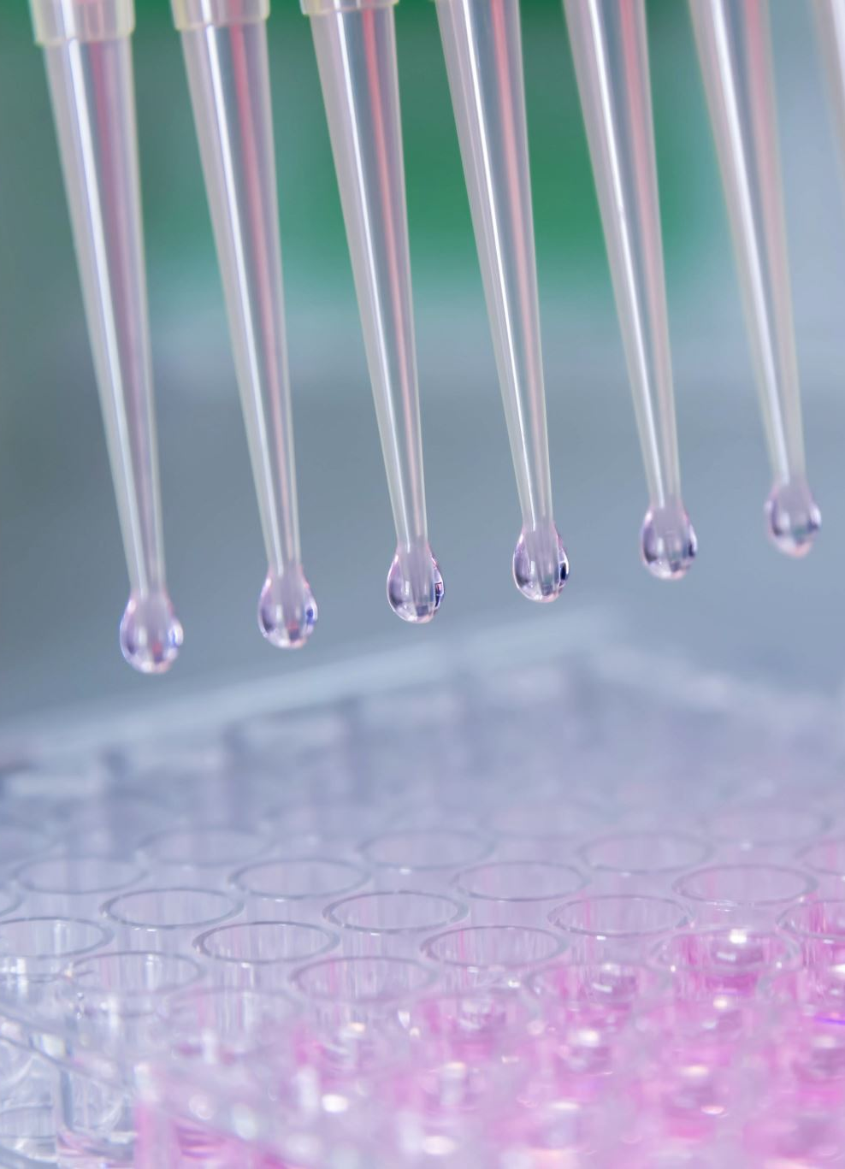
Introduction:
The project "Disease Diagnosis using Machine Learning“ aims to develop an intelligent system that leverages machine learning techniques to diagnose diseases accurately.
With the increasing availability of medical data and advancements in machine learning algorithms, this project focuses on utilizing these resources to build a reliable and efficient disease diagnosis system.
By analysing patient symptoms and medical records, the system will employ various ML algorithms to identify potential diseases and provide accurate diagnoses.
The project aims to improve the efficiency of disease diagnosis, assist health care professionals in decision-making ,and enhance patient care.

Slide 5

Types Of Data use for Disease Diagnosis
data is fetched from following data sets-
1) Symptom_description
2) Symptom_precaution
3) Symptom_severity

Slide 6
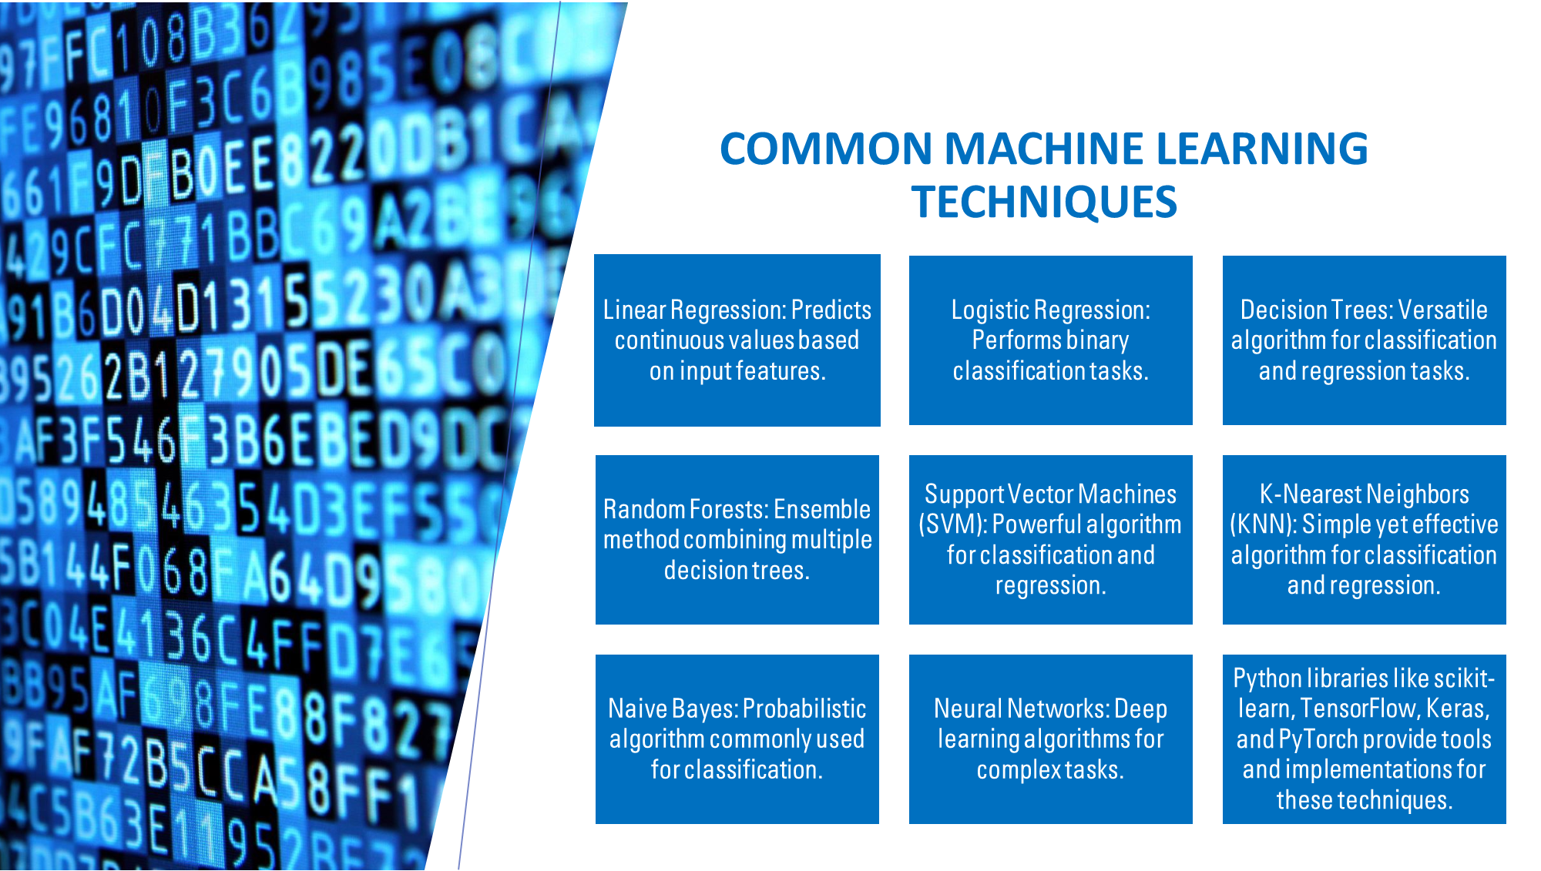

Slide 7
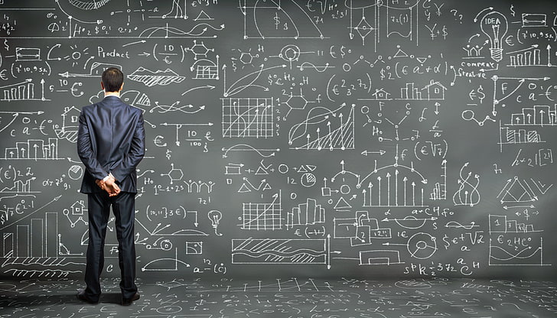


Methodology
System Overview
Hardware Setup
Data Acquisition
Data Processing
Real-time Monitoring

Slide 8
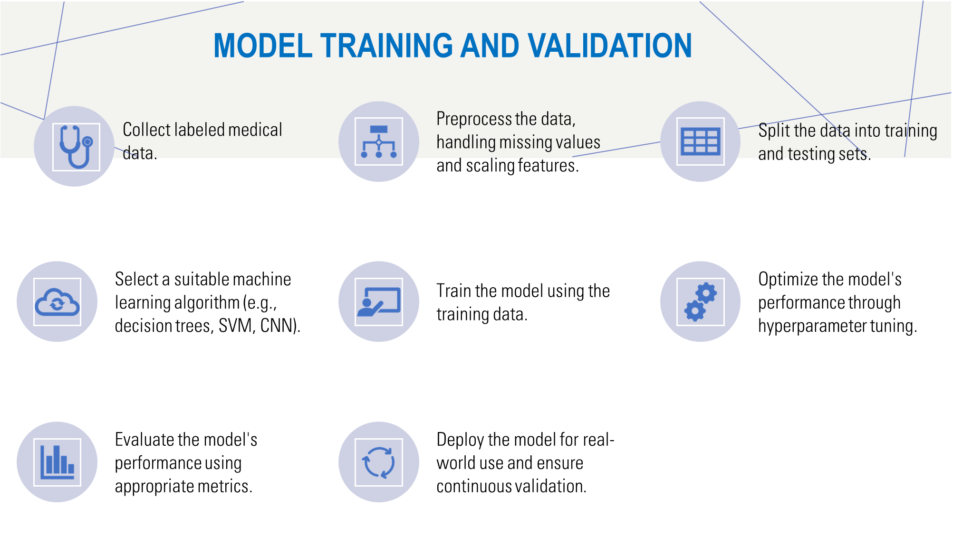

Slide 9
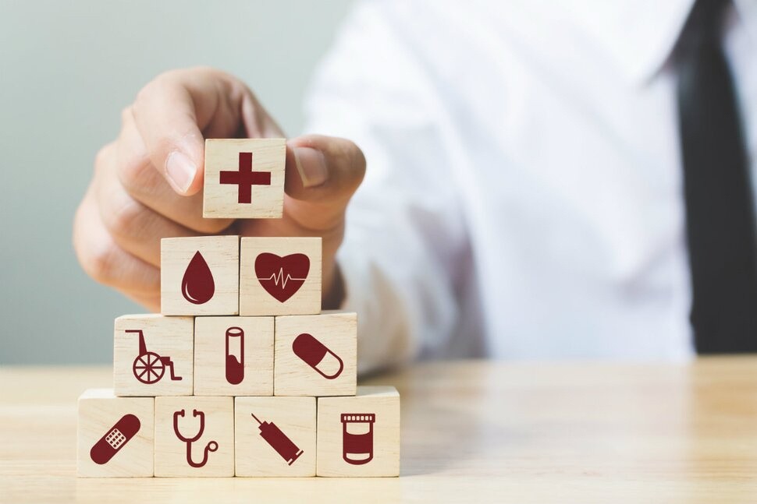

BENEFITS OF ML IN DISEASE DIAGNOSIS
Improved accuracy and reliability
Early detection of diseases
Efficient and faster diagnosis process
Personalized treatment plans
Decision support for healthcare professionals
Research insights and advancements in medical knowledge.

Slide 10
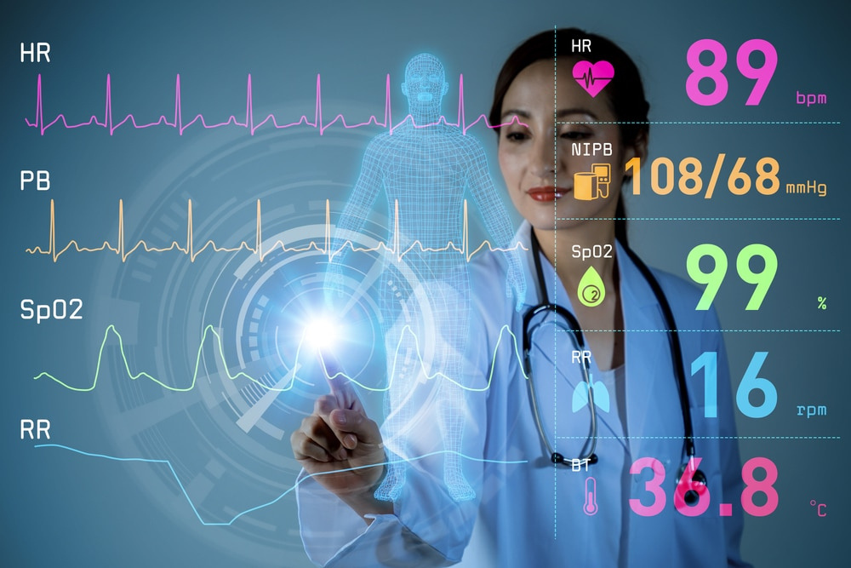

Challenges associated with implementing machine learning in healthcare
Data quality and availability
Interpretability and explainability
Ethical and legal considerations
Limited generalizability
Integration with clinical workflows
Regulatory and safety compliance
Clinician adoption and trust.

Slide 11
EXAMPLES OF ML IN DISEASE DIAGNOSIS
Diabetic Retinopathy Detection: Machine learning models analyze retinal images to diagnose diabetic retinopathy accurately, aiding in early intervention
Alzheimer's Disease Prediction: Machine learning models utilize neuroimaging data and patient information to predict the risk of developing Alzheimer's disease, enabling early detection and intervention.
COVID-19 Diagnosis: Machine learning models analyze chest CT scans or patient symptoms to assist in diagnosing COVID-19, helping to triage patients and allocate resources effectively.
Pneumonia Detection from Chest X-rays: Machine learning algorithms analyze chest X-ray images to identify pneumonia, supporting radiologists in accurate diagnosis and treatment planning.

Slide 12
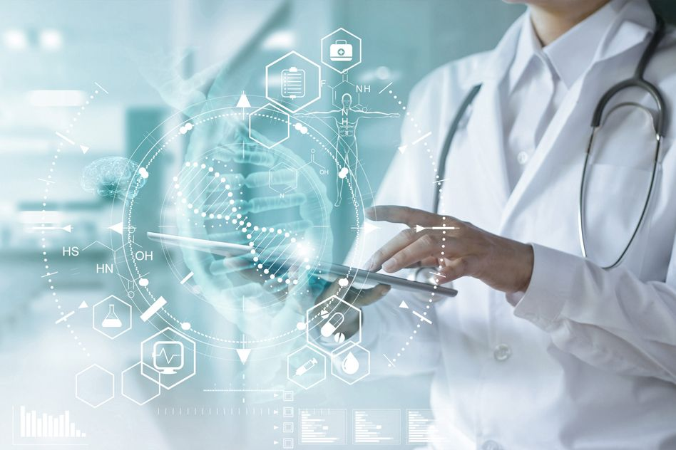
Future Directions
Early detection and prevention through refined models.
Personalized medicine with optimized treatment plans.
Integration of diverse medical data for comprehensive diagnosis.
Real-time monitoring and decision support for timely interventions.
Collaboration and knowledge sharing for accelerated research.
Advancements in explainable AI for increased interpretability.
Combining clinical expertise with machine learning for improved diagnostics.

Slide 13
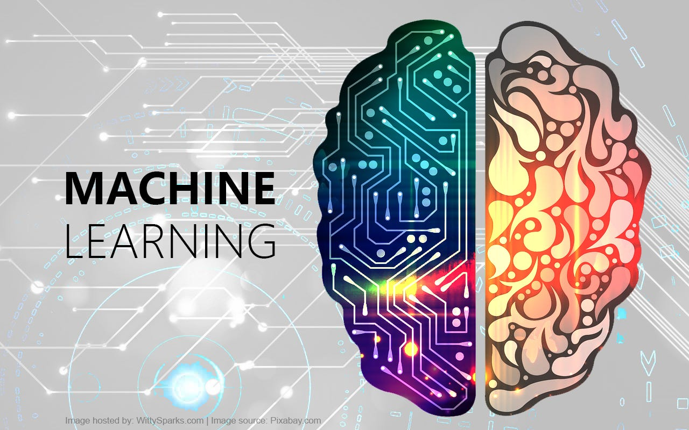
CONCLUSION
Enables accurate and efficient diagnosis using medical data.
Successful case studies demonstrate effectiveness.
Improves accuracy, efficiency, and personalized treatment.
Challenges include data quality, ethics, and integration.
Future advancements: early detection, personalized medicine, and emerging technologies.

Slide 14
Thank You

